Slide 1
The Danceability
Index

Slide 2
Disclaimer
The summary description of Danceability Index (“The Strategy”) included herein, and any other materials provided to you, are intended only for discussion purposes and are not intended as an offer to sell or a solicitation of an offer to buy with respect to the purchase or sale of any security and should not be relied upon by you in evaluating the merits of investing in any securities. These materials are not intended for distribution to, or use by, any person or entity in any jurisdiction or country where such distribution or use is contrary to local law or regulation.
This summary is not intended to be complete, and material aspects of the descriptions contained herein may change at any time. The information herein is not intended to provide, and should not be relied upon for, accounting, legal or tax advice or investment recommendations. You should consult your tax, legal, accounting or other advisors about the matters discussed herein.
An investment in the Strategy will be suitable only for certain sophisticated investors who have no need for immediate liquidity in their investment. Such an investment will provide limited liquidity because interests will not be freely transferable and may be withdrawn infrequently and only under certain limited circumstances. There will be no public or secondary market for interests in the Strategy, and it is not expected that a public or secondary market will develop.
Investing in financial markets involves a substantial degree of risk. There can be no assurance that the investment objectives described herein will be achieved. Investment losses may occur, and investors could lose some or all of their investment. Nothing herein is intended to imply that an investment in the Strategy or its investment strategies may be considered "conservative," "safe," "risk free" or "risk averse". No regulatory authority has passed upon or endorsed this summary or the merits of an investment in the Strategy.
The examples of investments included in this summary have been provided for discussion purposes only and are no guarantee of future results
Distribution of this information to any person other than the person to whom this information was originally delivered and to such person's advisors is unauthorized and any reproduction of these materials, in whole or in part, or the disclosure of any of the contents, without the prior consent is prohibited. Notwithstanding anything to the contrary herein, each recipient of this summary (and each employee, representative or agent of such recipient) may disclose to any and all persons, without limitation of any kind, the tax treatment and tax structure of (i) the Strategy and (ii) any of its transactions, and all materials of any kind (including opinions or other tax analyses) relating to such tax treatment and tax structure.

Slide 3
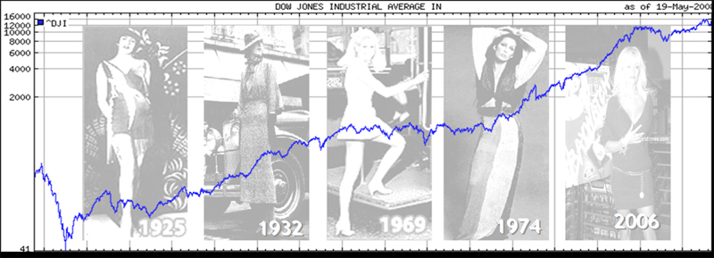
The Hemline Index
Wikipedia: “The theory suggests that hemlines on women's dresses rise along with stock prices. In good economies, we get such results as miniskirts (as seen in the 1960s),or in poor economic times, as shown by the 1929 Wall Street Crash, hems can drop almost overnight.”
Image Source: http://www.ritholtz.com/blog/wp-content/uploads/2010/09/Hemline-1-.jpg

Slide 4

The Danceability Index
Theory: Dancing without moderation suggests a peak of irrational exuberance. When dancing reaches a maximal level, the market may be overvalued.
Image source: http://alliedow.wordpress.com/2009/11/17/dancing-in-your-nuddy-pants/

Slide 5


Data Sources
Weekly Historical Top 5 songs
in New York City
Danceability Score of Top Songs

Slide 6
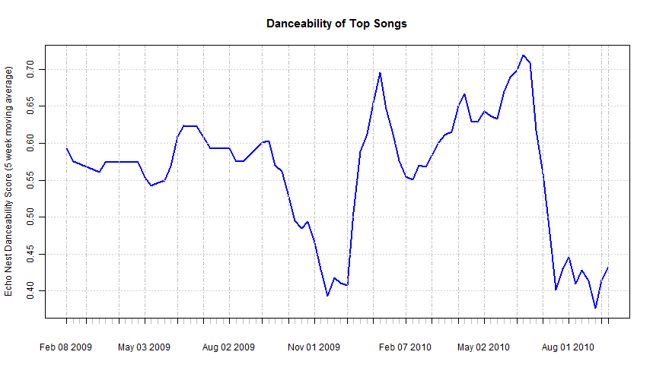
Analysis - Danceability

Slide 7
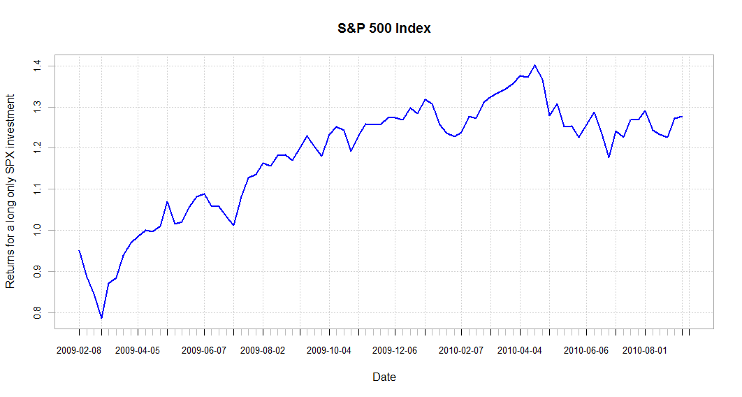
Analysis – S&P Returns

Slide 8
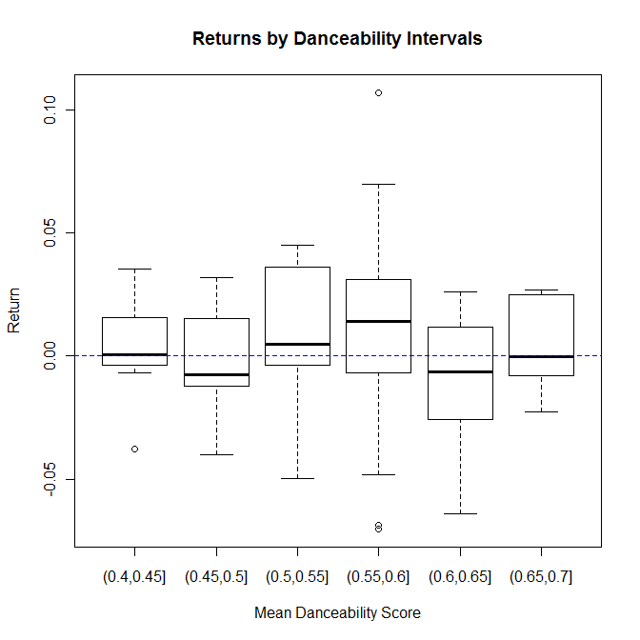

Slide 9
Rule:
Go long in the S&P 500
Sell short if danceability index > 0.6

Slide 10
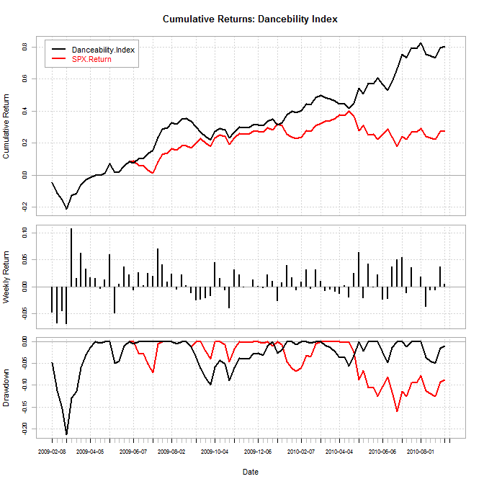
Results

Slide 11
Results – Performance Statistics
DanceStrategy Historical Performance by Month Gross of Fees
Dance Strategy | Jan | Feb | Mar | Apr | May | Jun | Jul | Aug | Sep | Oct | Nov | Dec | YTD
2010 | 2.83% | 6.80% | -1.44% | -0.85% | 10.67% | 3.61% | 7.73% | 0.26% | 2.83% |  |  |  | 35.2%
2009 |  | -15.37% | 14.61% | 4.16% | 7.13% | 4.73% | 14.49% | 2.93% | -8.81% | 1.07% | 6.74% | 2.88% | 32.9%
Risk/Return Statistics based on Dance Strategy Historical Performance (Feb 09 – Oct 10)
Net Cumulative Return | Net Annualized Return | Net Annualized Volatility | Net Annualized Sharpe Ratio (rf=0) | Maximum Drawdown | Correlation with S&P 500
79.7% | 44.79% | 24.74% | 1.8 | -21.3% | 0.53

Slide 12
Global Marketing & Investor Relations
For additional information, please contact:
Joe Rothermich Dance Dance Investing, LLC joe.rothermich @ gmail . com

